Slide 1
P, NP, and NP-Complete
CS 330 Intro to the Design and Analysis of Algorithms
Lecture note
Sajedul Talukder

Slide 2
Polynomial Time
Most (but not all) of the algorithms we have studied so far are easy, in that they can be solved in polynomial time, be it linear, quadratic, cubic, etc.
Cubic may not sound very fast, and isn’t when compared to linear, but compared to exponential we have seen that it has a much better asymptotic behavior.
There are many algorithms which are not polynomial. In general, if the space of possible solutions grows exponentially as n increases, then we should not hope for a polynomial time algorithm. These are the exception rather than the rule.

Slide 3
The class P
The class P consists of those problems that are solvable in polynomial time.
More specifically, they are problems that can be solved in time O(n^{k}) for some constant k, where n is the size of the input to the problem
The key is that n is the size of input

Slide 4
Hard Problems
Problems with no known polynomial solution are called Hard problems.
Another class of problems (NP) seem like they should be easy. They have the following property:
A solution can be verified in polynomial time.
Consider the following very common example called Satisfiability: (SAT)
Input: A Boolean expression, F, over n variables (x1,. ..,xn)
Output: 1 if the variables of F can be fixed to values which make F equal true; 0 otherwise.

Slide 5
Circuit-SAT
Logic Gates
1
0
0
1
1
NOT
1
1
0
OR
1
1
0
0
1
AND
Take a Boolean circuit with a single output node and ask whether there is an assignment of values to the circuit’s inputs so that the output is “1”

Slide 6
NP Problems
NP stands for non-deterministic polynomial time.
The basic premise is we could guess at a solution and then test whether we guessed right or not easily. Guessing is of course non-deterministic!
So, think of this as guessing in polynomial time. No guarantee that you will ever guess correctly though.

Slide 7
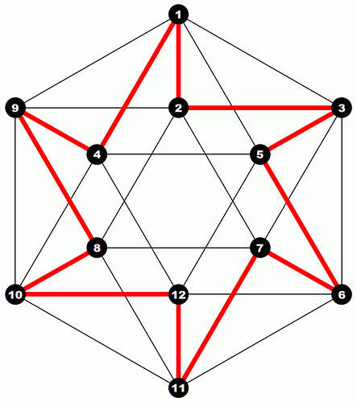
Hamiltonian Path
Instance: a directed graph G=(V,E) and start vertex s∈V.
Problem: To decide if there exists a path from s, which goes through each node once.
Hamiltonian Cycle: Is there a path that visits each vertex exactly once and comes back to start vertex.

Slide 8
Reducibility
a problem Q can be reduced to another problem Q’ if any instance of Q can be “easily rephrased” as an instance of Q’, the solution to which provides a solution to the instance of Q
Is a linear equation reducible to a quadratic equation?
Sure! Let coefficient of the square term be 0

Slide 9
Reduction
A problem R can be reduced to another problem Q if any instance of R can be rephrased to an instance of Q, the solution to which provides a solution to the instance of R
– This rephrasing is called a transformation
Intuitively: If R reduces in polynomial time to Q, R is “no harder to solve” than Q
Example: lcm(m, n) = m * n / gcd(m, n),
lcm(m,n) problem is reduced to gcd(m, n) problem

Slide 10
Polynomial Time Reductions
The SAT problem is a circuit, so it is very useful and interesting. Can we write a program to do X? This and many other problems have been studied at length.
There are many mappings (called reductions) that have been discovered that map one problem to the other, so if we solve one we can solve the other.
Moreover, these mappings are polynomial time mappings.

Slide 11
NP-hard
What are the hardest problems in NP?
That notation means that L₁ is reducible in polynomial time to L₂ .
The less than symbol basically means that the time taken to solve L₁ is no worse that a polynomial factor away from the time taken to solve L₂.
A problem (a language) is said to NP-hard if every problem in NP can be poly time reduced to it.

Slide 12
NP-Complete
The set of NP problems that can be mapped to each other in polynomial time is called NP-Complete.
It is difficult to prove that something can not be done.
Let me repeat that, it is difficult to prove that something can not be done.
So, while we know how to solve many of these algorithms in exponential time, whose to say that one of you bright students won’t come up with a clever polynomial time algorithm!
NP-Complete is useful from that standpoint, if any of them turns out to have a polynomial time algorithm, they all do (hence P=NP).
Of course, us old professors feel that these problems have been looked at from every angle and no such solution will ever be found (hence, P ≠ NP).

Slide 13
NP Complete problems/languages
Need to be in NP
Need to be in NP-Hard
If both are satisfied then it is an NP complete problem
Reducibility is a transitive relation.
If we know a single problem in NP-Complete that helps when we are asked to prove some other problem is NP-Complete
Assume problem P is NP Complete
All NP problems are reducible to this problem
Now given a different problem P’
If we show P reducible to P’
Then by transitivity all NP problems are reducible to P’

Slide 14
NP-Complete
It is also useful to know these algorithms, as they occur frequently in real applications and tackling them in a brute force fashion may be disastrous.
SAT problem
Traveling Salesman problem
Knapsack Problem
Longest Path
Graph Clique

Slide 15
P is a subset of NP
Since it takes polynomial time to run the program, just run the program and get a solution
But is NP a subset of P?
No one knows if P = NP or not
Solve for a million dollars!
http://www.claymath.org/millennium-problems
The Poincare conjecture is solved today

Slide 16
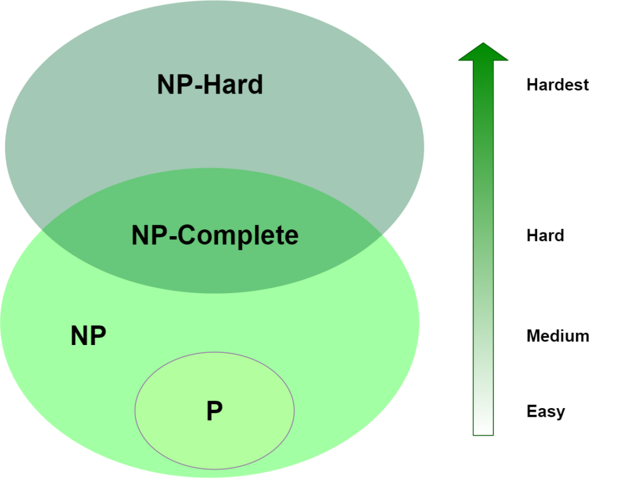
P, NP, NP-Hard

Slide 17
Amusing analogy (thanks to lecture notes at University of Utah)
Students believe that every problem assigned to them is NP-complete in diﬃculty level, as they have to ﬁnd the solutions.
Teaching Assistants, on the other hand, ﬁnd that their job is only as hard as NP, as they only have to verify the student’s answers.
When some students confound the TAs, even veriﬁcation becomes hard

Slide 18
The Traveling Salesman Problem
Given a set of cities and distances between every pair of cities, the problem is to find the shortest possible route that visits every city exactly once and returns to the starting point.
The goal of the Traveling Salesman Problem (TSP) is to find the most economical way to tour of a select number of “cities” with the following restrictions:
You must visit each city once and only once
You must return to the original starting point

Slide 19
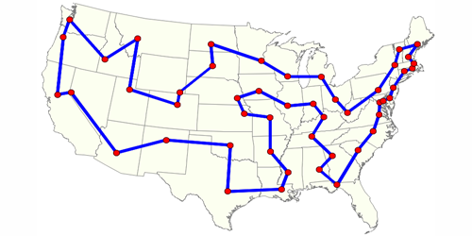
The Traveling Salesman
A genetic algorithm for a computationally demanding problem
Maps and Tours
Exhaustive Search
Random Search
Point Mutations
The Genetic Algorithm
Crossovers

Slide 20
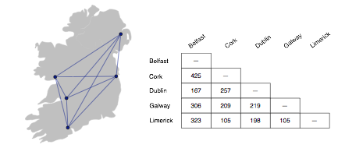
Bike Tour
Suppose you decide to ride a bicycle around Ireland
you will start in Dublin
the goal is to visit Cork, Galway, Limerick, and Belfast before returning to Dublin
What is the best itinerary?
how can you minimize the number of kilometers yet make sure you visit all the cities?

Slide 21
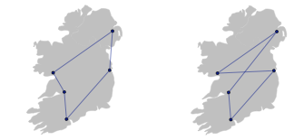
Optimal Tour
If there are only 5 cities it’s not too hard to figure out the optimal tour
the shortest path is most likely a “loop”
any path that crosses over itself will be longer than a path that travels in a big circle

Slide 22
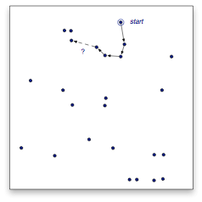
Increasing the Number of Cities
As we add cities to our tour, however, it is much harder to figure out the optimal tour
a simple strategy of going to the closest city does not always lead to the shortest tour
this example has 25 cities
after visiting 4 cities, where would you go next?
Hint: going to this city does not lead to the shortest tour...

Slide 23
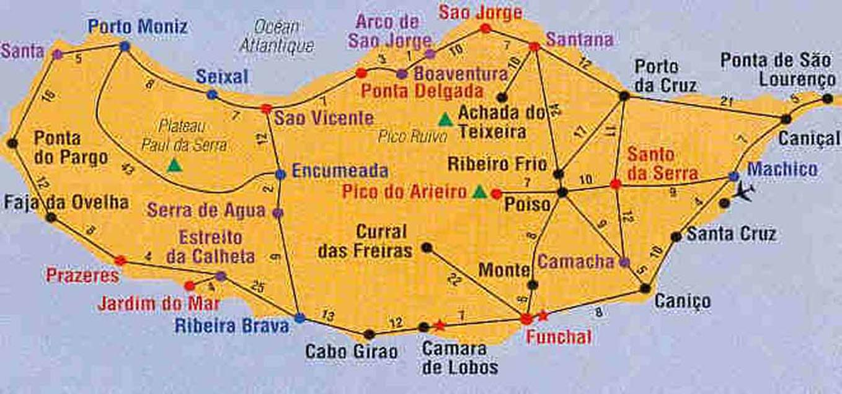
Total distance = xxx miles

Slide 24
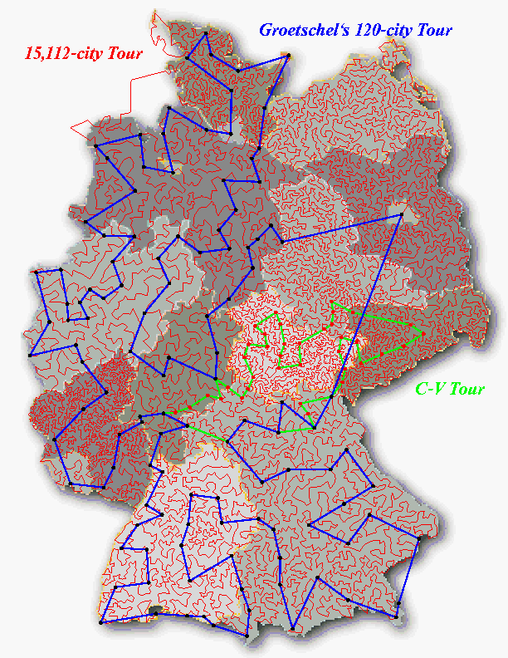
15,112 Cities in Germany
Optimal result found in 2001 has approximately 66,000 kilometers
The computation was carried out on a network of 110 processors located at Rice and Princeton.
13,509 city tour through the United States was solved in 1998.

Slide 25
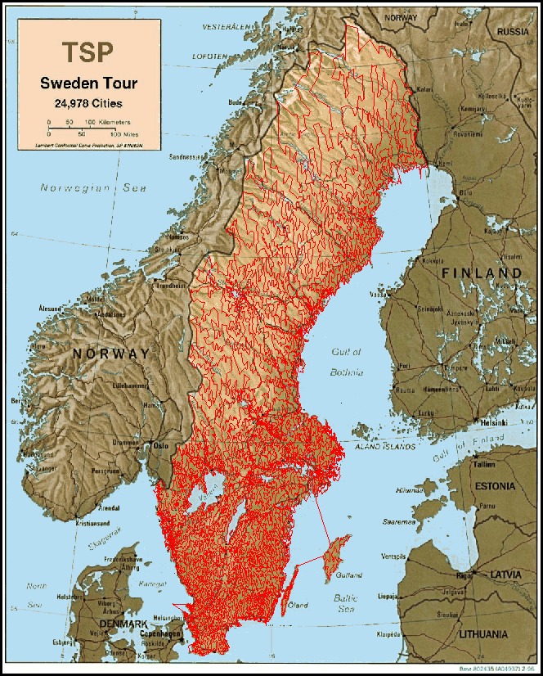
24,978 cities in Sweden
In May 2004, the traveling
salesman problem of visiting
all 24,978 cities in Sweden
was solved: This is currently
the largest solved TSP
Instance.

Slide 26
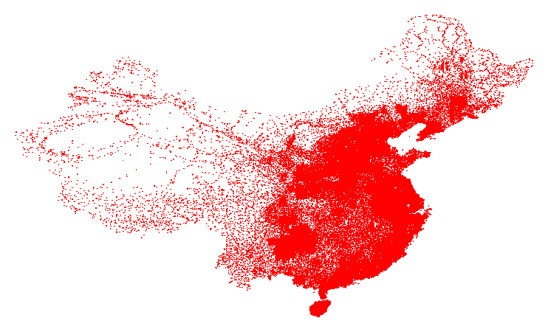
71009 in China
Best known result by Hung Dinh Nguyen, 4,566,563.

Slide 27
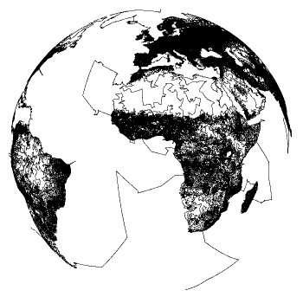
1,904,711 Cities in the World
Best known result by Keld Helsgaun, 7,516,146,716 December 2003

Slide 28
Real-Life Applications
It’s not likely anyone would want to plan a bike trip to 25 cities
But the solution of several important “real world” problems is the same as finding a tour of a large number of cities
transportation: school bus routes, service calls, delivering meals, ...
manufacturing: an industrial robot that drills holes in printed circuit boards
VLSI (microchip) layout
communication: planning new telecommunication networks
For many of these problems n (the number of “cities”) can be 1,000 or more

Slide 29
Exhaustive Search
Problem: Find the optimal tour in a graph G = (V,E)
Sub-problem: Does G contain a Hamiltonian cycle?
No known easy algorithm for checking this…
One solution: Search through all paths to find one that visits each vertex exactly once
Can use your favorite graph search algorithm (DFS!) to find various paths
This is an exhaustive search (“brute force”) algorithm since all combinations are tried
Worst case → need to search all paths
How many paths??

Slide 30
Exhaustive Search Algorithm
Consider city 1 as the starting and ending point. Since route is cyclic, we can consider any point as starting point.
Generate all (n-1)! permutations of cities.
Calculate cost of every permutation and keep track of minimum cost permutation.
Return the permutation with minimum cost.

Slide 31
TSP
#include <iostream>
#include <bits/stdc++.h>
using namespace std;
#define V 4
int travllingSalesmanProblem(int graph[][V], int s)
{
// store all vertices
vector<int> vertex;
for (int i = 0; i < V; i++)
if (i != s)
vertex.push_back(i);
int min_path = INT_MAX;
do {
int current_pathweight = 0;
int k = s;
for (int i = 0; i < vertex.size(); i++) {
current_pathweight += graph[k][vertex[i]];
k = vertex[i];
}
current_pathweight += graph[k][s];
// update minimum
min_path = min(min_path, current_pathweight);
} while (next_permutation(vertex.begin(), vertex.end()));
return min_path;
}
// driver program to test above function
int main()
{
// matrix representation of graph
int graph[][V] = { { 0, 10, 15, 20 },
{ 10, 0, 35, 25 },
{ 15, 35, 0, 30 },
{ 20, 25, 30, 0 } };
int s = 0;
cout << travllingSalesmanProblem(graph, s) << endl;
return 0;
}

Slide 32
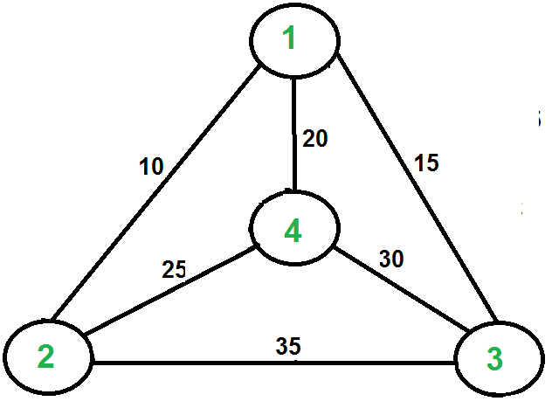
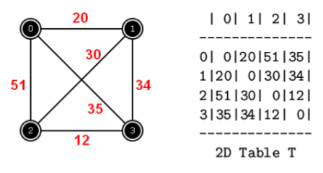
Examples

Slide 33
Analysis of our Exhaustive Search Algorithm
Worst case → need to search all paths
How many paths?
Can depict these paths as a search tree
Let the average branching factor of each node in this tree be B
|V| vertices, each with ≈ B branches
Total number of paths ≈ B·B·B … ·B
= O(B^{|V|})
Worst case → Exponential time!
B
C
G
D
E
B
D G C
G E D E C G E
Etc.
Search tree of paths from B

Slide 34
Too Many Tours
There is a problem with the exhaustive search strategy
the number of possible tours of a map with n cities is (n − 1)! / 2
n! (pronounced “n factorial”) is the product n × (n − 1) × (n − 2) ... × 2 × 1
The number of tours grows incredibly quickly as we add cities to the map
#cities | #tours
5 | 12
6 | 60
7 | 360
8 | 2,520
9 | 20,160
10 | 181,440
The number of tours for 25 cities:
310,224,200,866,619,719,680,000

Slide 35
How bad is exponential time?
N | log N | N log N | N² | 2^{N}
1 | 0 | 0 | 1 | 2
2 | 1 | 2 | 4 | 4
4 | 2 | 8 | 16 | 16
10 | 3 | 30 | 100 | 1024
100 | 7 | 700 | 10,000 | 1,000,000,000,000,00,000,000,000,000,000
1000 | 10 | 10,000 | 1,000,000 | Fo’gettaboutit!
1,000,000 | 20 | 20,000,000 | 1,000,000,000,000 | ditto

Slide 36
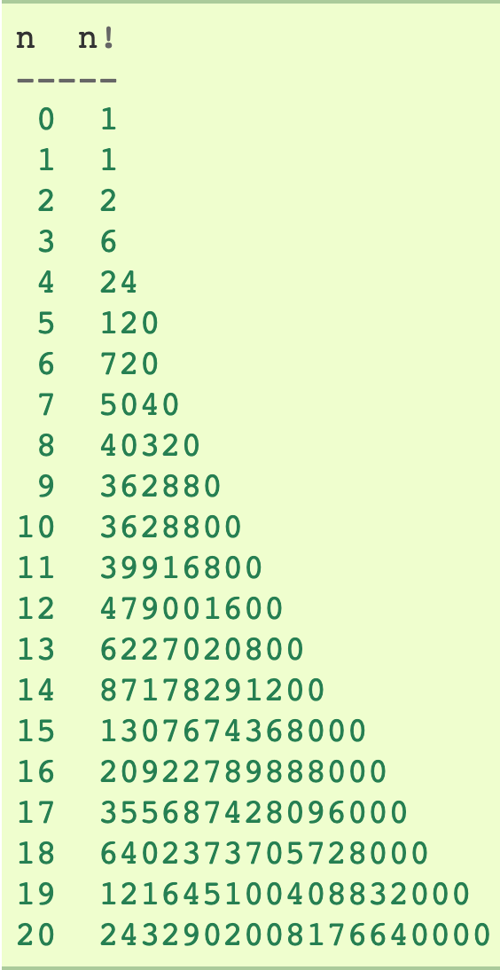
Time Complexity of TSP (n = number of vertices)

Slide 37
Time Complexity of TSP (n = number of vertices)

